Slide 1


Fighting Cybercrime using Digital Forensics

Slide 2
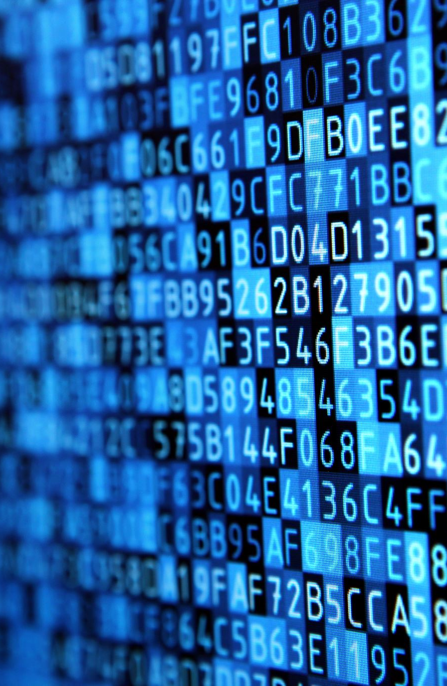
Session Outline
Digital Forensics:
What is digital forensics
Forensic processes
Investigative mindset
Analysis of a suspect disk image
Tools for this session:
Autopsy for Windows
Hunter XP demo case

Slide 3
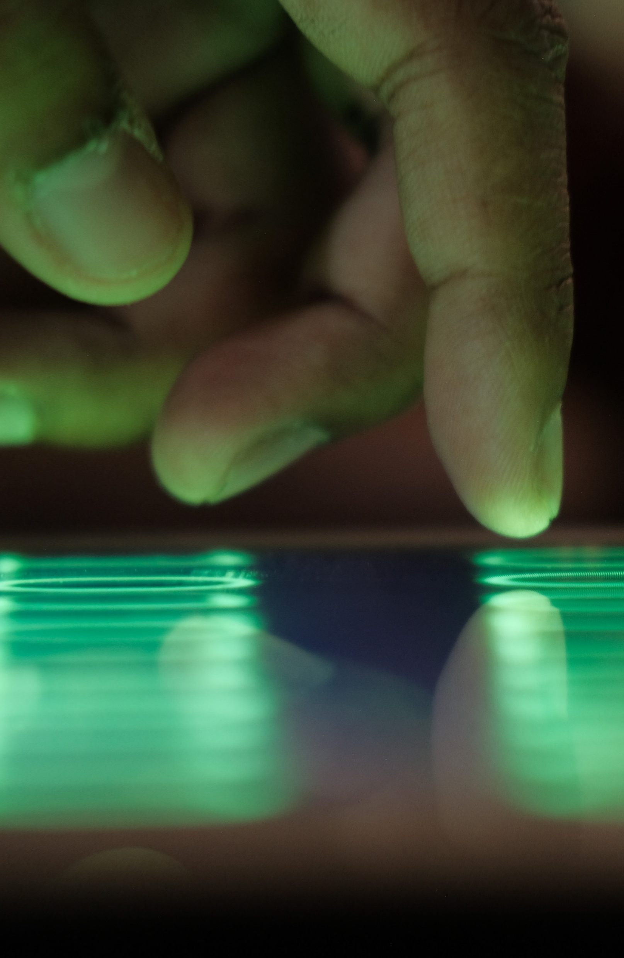
What is Cybercrime?
The UK Government defines Cybercrime as:
Cyber-dependent crimes - crimes that can be committed only through the use of Information and Communications Technology (‘ICT’) devices, where the devices are both the tool for committing the crime, and the target of the crime (e.g. developing and propagating malware for financial gain, hacking to steal, damage, distort or destroy data and/or network or activity).
Cyber-enabled crimes - traditional crimes which can be increased in scale or reach by the use of computers, computer networks or other forms of ICT (such as cyber-enabled fraud and data theft).
Source: https://www.cps.gov.uk/legal-guidance/cybercrime-prosecution-guidance

Slide 4
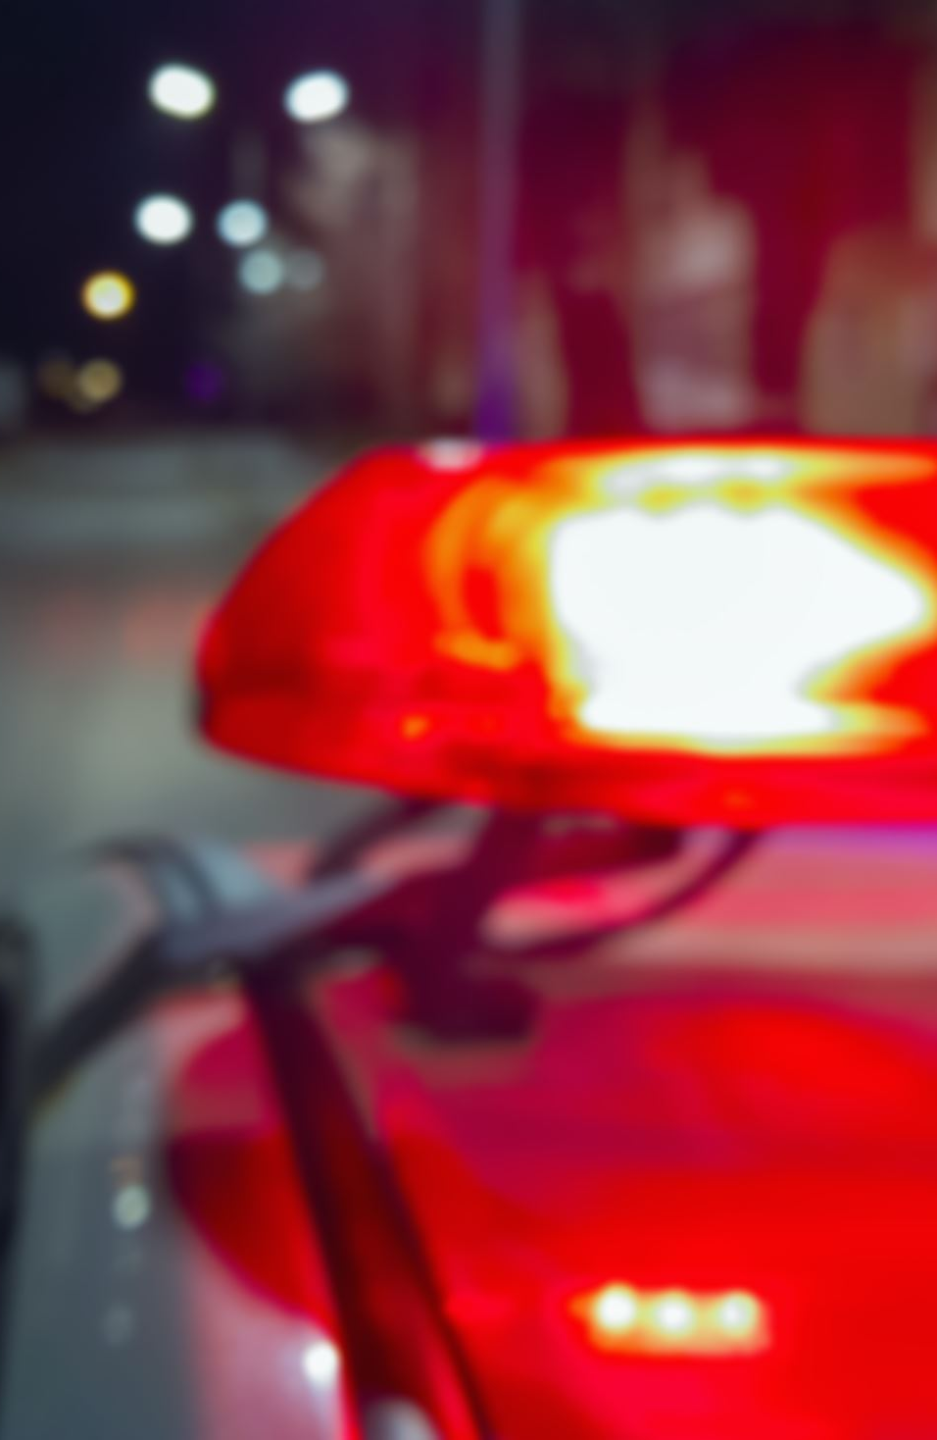
How do we deal with Cybercrime?
Digital Forensic Investigation
“The use of scientifically derived and proven methods toward the preservation, collection, validation, identification, analysis, interpretation, documentation and presentation of digital evidence derived from digital sources for the purpose of facilitating or furthering the reconstruction of events found to be criminal or helping to anticipate unauthorized actions shown to be disruptive to planned operations.”
Source: Digital Forensic Research Workshop (DFRWS), 2001

Slide 5
Forensic Process
Identification
Locate evidence.
Preservation & Acquisition
Isolate, secure and preserve data
Examination & Analysis
Examine data and draw conclusions
Create a record of findings
Documentation
Presentation
Summarize findings and draw conclusions.

Slide 6

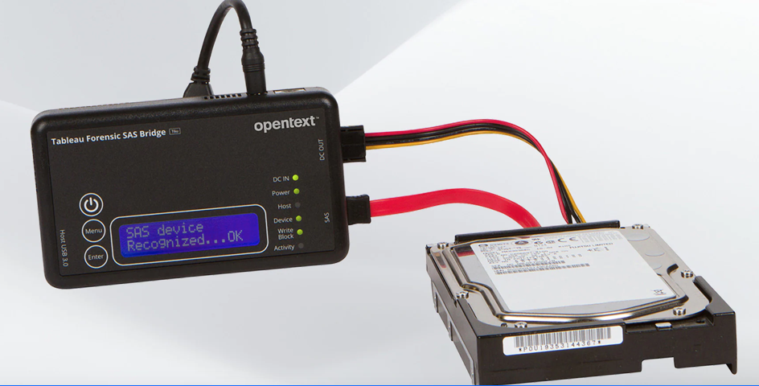
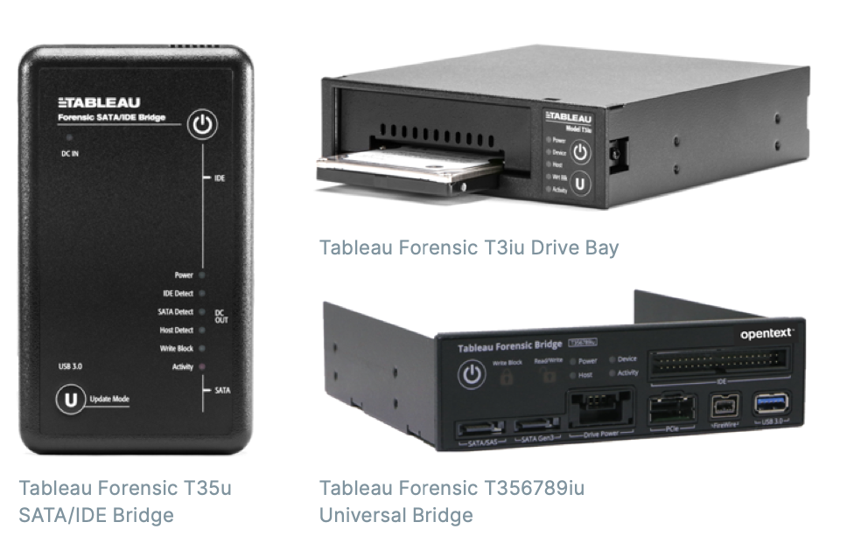
Acquisition
Preservation of data is essential
Cloning suspect hard drive to an image file
Hardware write blocker
Ensure that no new data is written to a suspect drive
Documentation and chain of custody
Written records of each process followed and who carried out tasks involved.

Slide 7
Forensic Analysis
Dead analysis
Examination of the suspect machine in a non-booted fashion.
Use of case management software.
Conducting operations on the suspect image or drive without modification.
Live analysis
Examination of the suspects machine in a booted fashion.
Useful for understanding how a piece of malware is behaving.

Slide 8
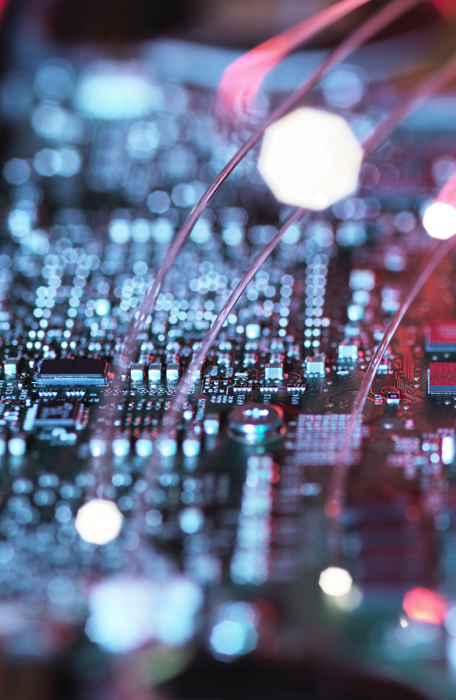
Examination & Analysis
Investigative Mindset
Knowledge of OS/FS/Apps
Knowledge of Forensic Tools

Slide 9
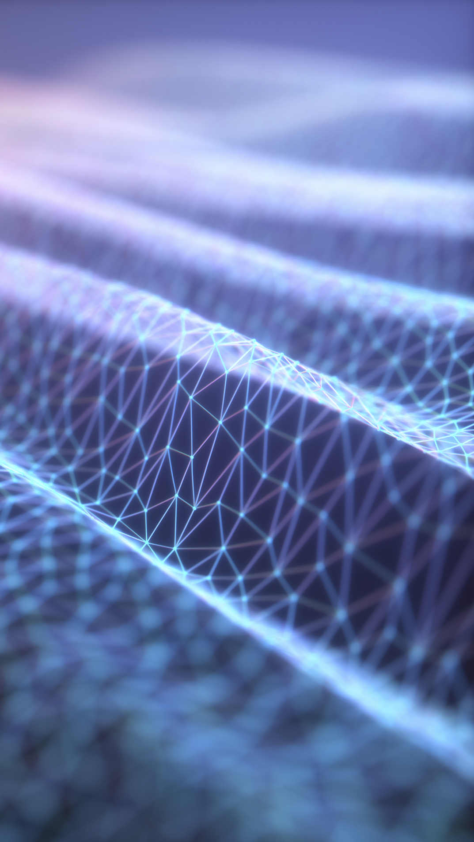
Activity: Autopsy
Open Autopsy 4.20.0
Add a new case.
Enter a name for your case and select a base directory, such as in your documents area.
Select Host: Generate new host name based on data source.
Import the ‘Hunter XP’ disk image.
Leave the ingestion options as they are and click next.
Click finish once the ingestion has completed.
Notes:
10 mins

Slide 10

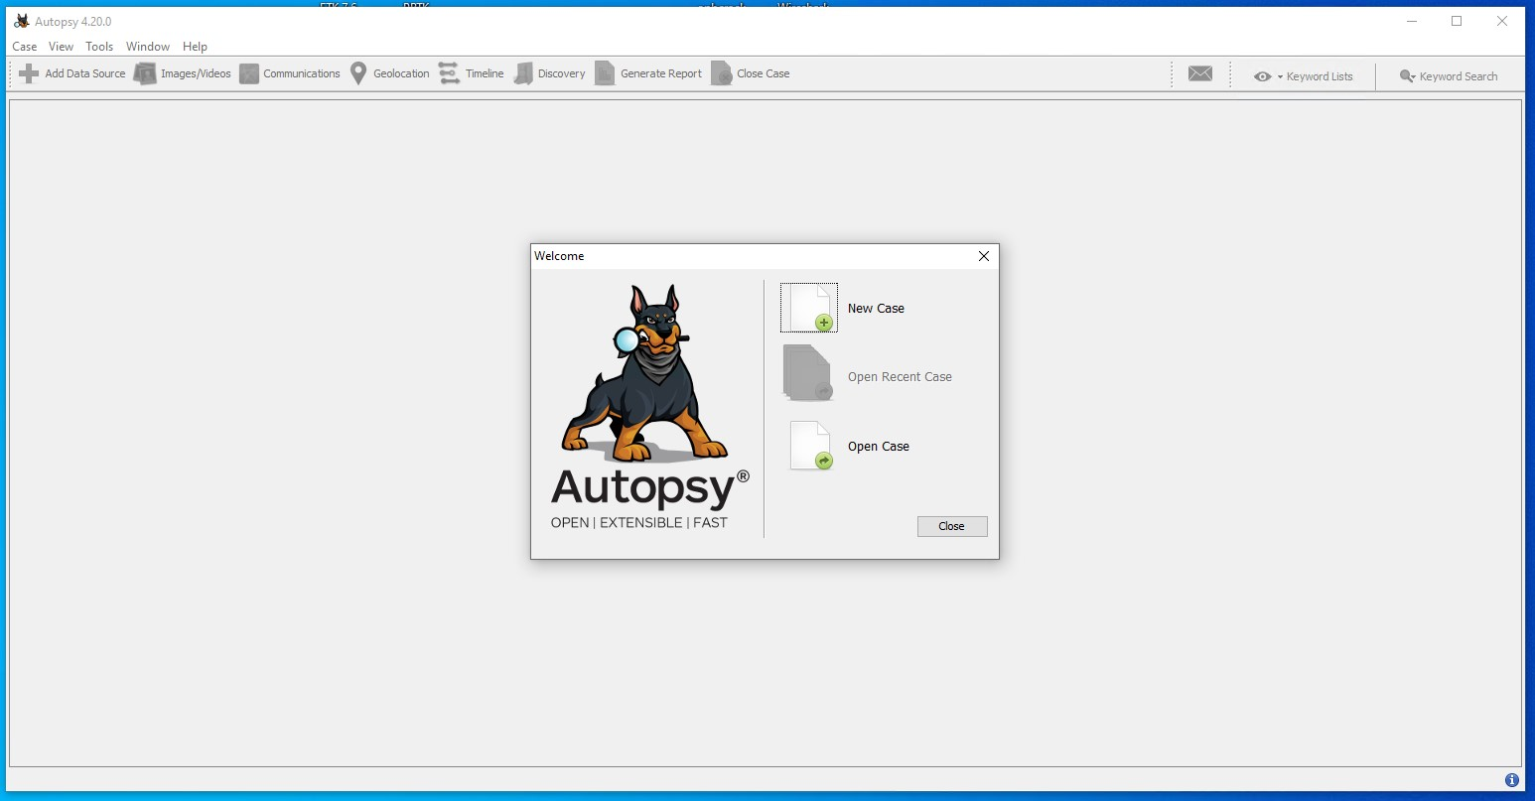
Notes:
1) Open Autopsy

Slide 11
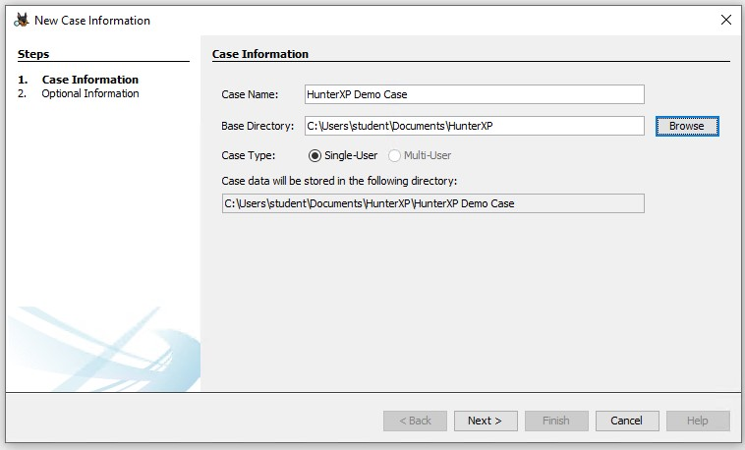
Notes:
2) Creating a new case for Hunter XP

Slide 12
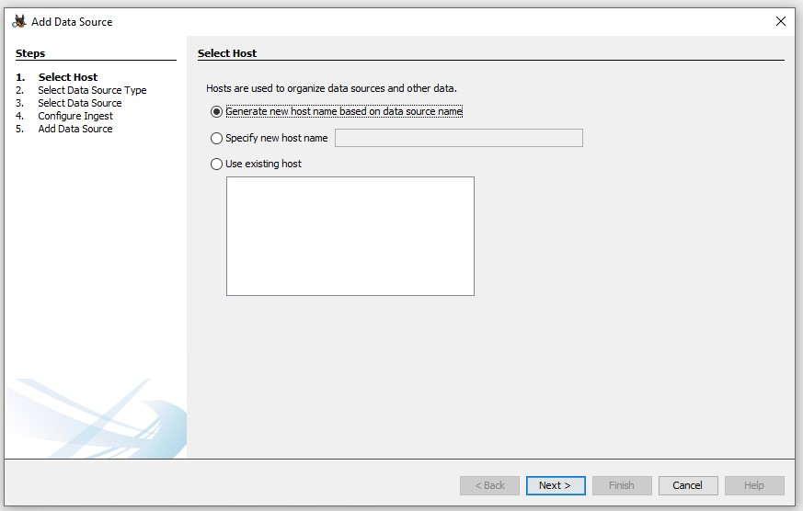
Notes:
3) Generate new host name

Slide 13
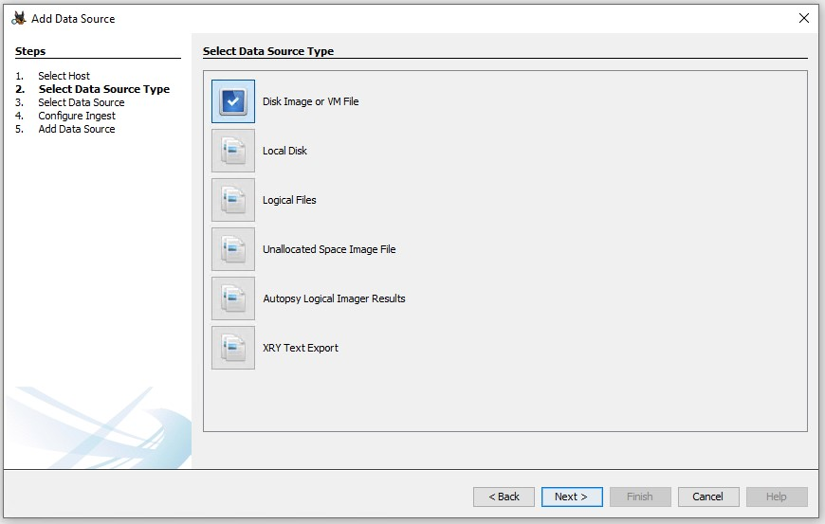
Notes:
4) Data source is a disk image

Slide 14
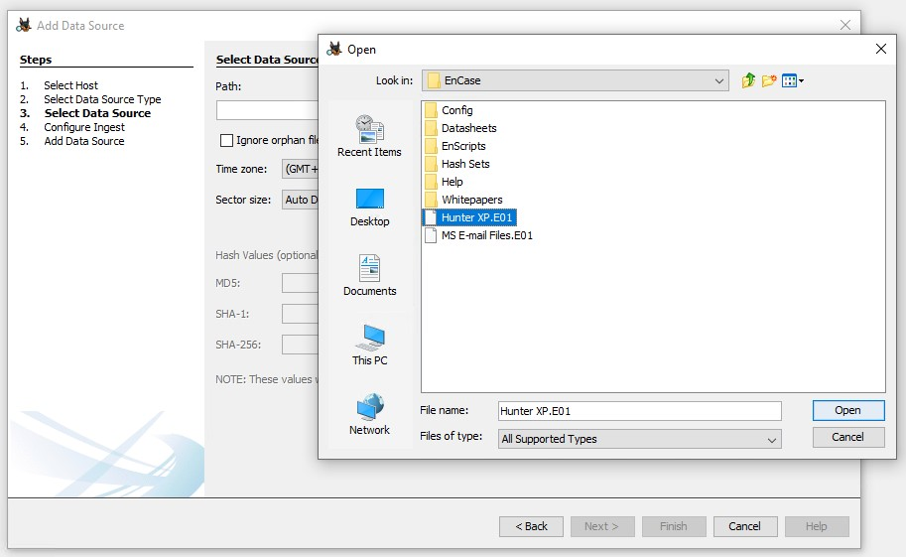
Notes:
5) Locate and load the Hunter XP image – note its location may not be identical to this screenshot depending on how the session has been prepared for your students.

Slide 15
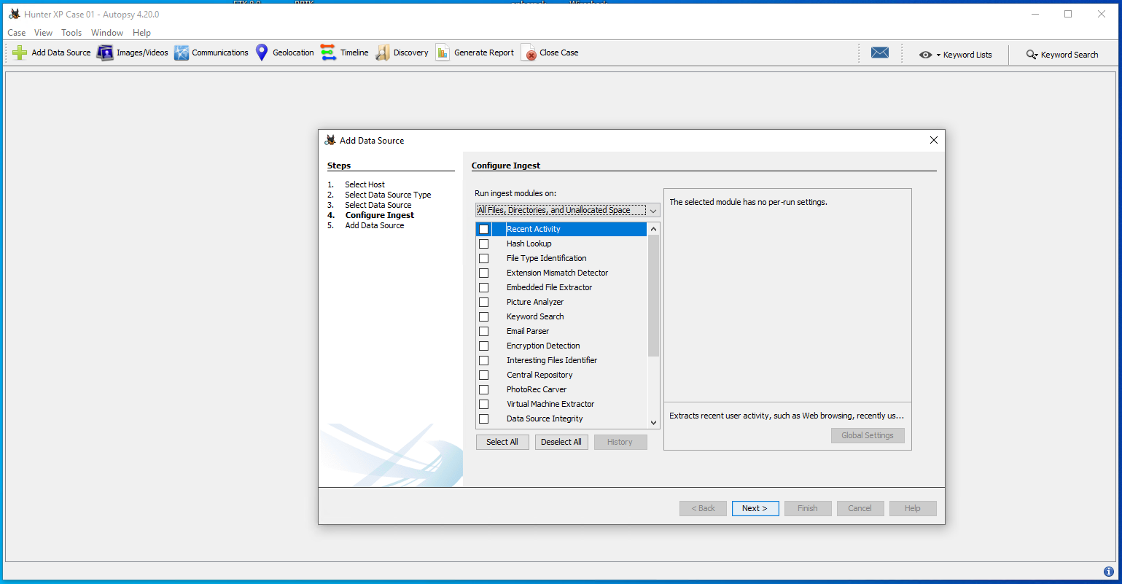
Notes:
6) Deselect all of the ingestion modules if they are selected.

Slide 16
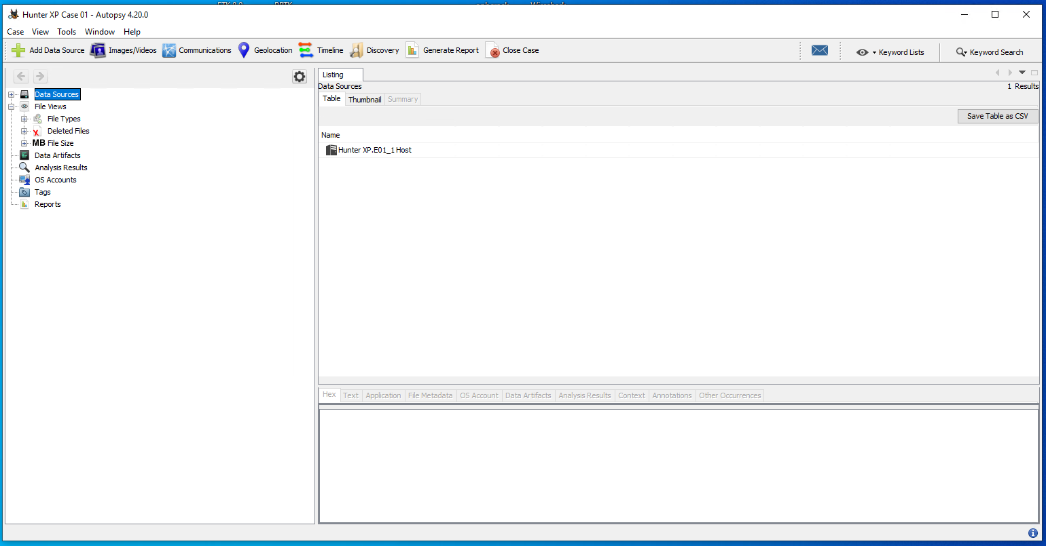
Notes:
7) Case setup has been successful and students can start exploring the results.

Slide 17
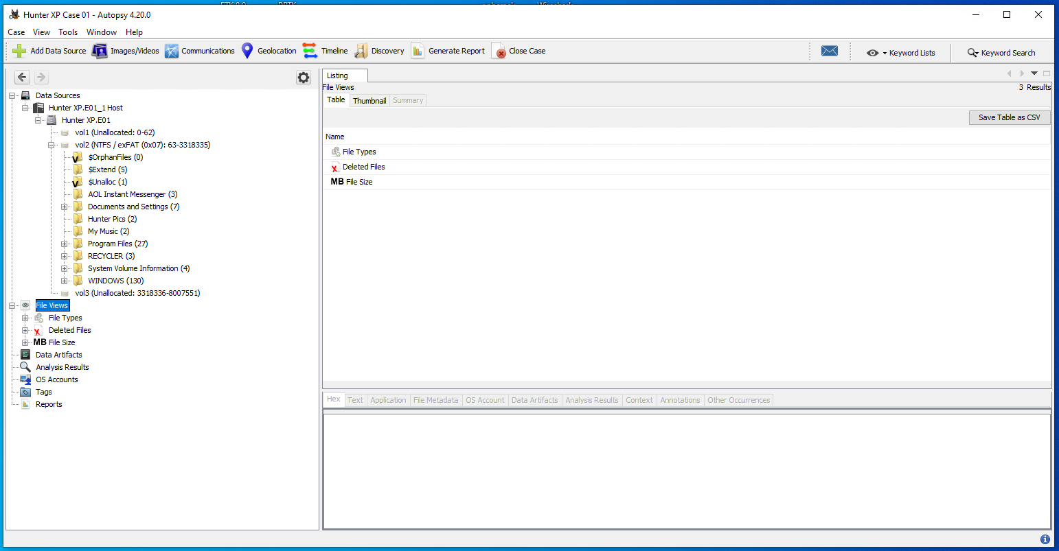
Notes:
8) If we look at the allocated file space, we can see the file system for a Windows installation.

Slide 18
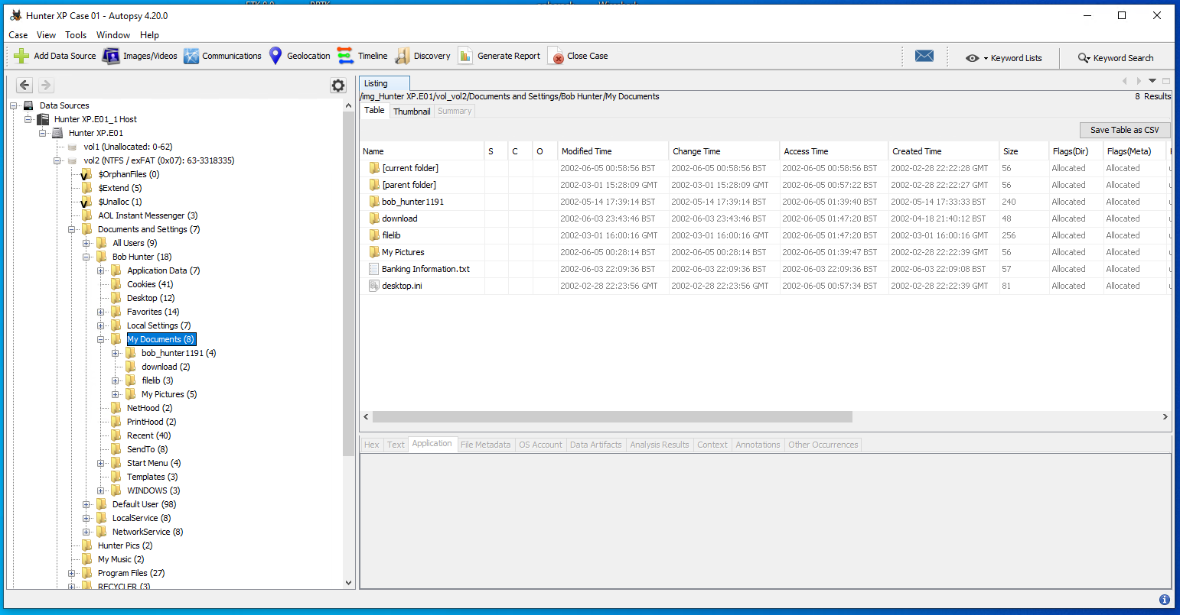
Notes:
9) We can start to explore the detected file system, such as having a look in the my documents area.

Slide 19
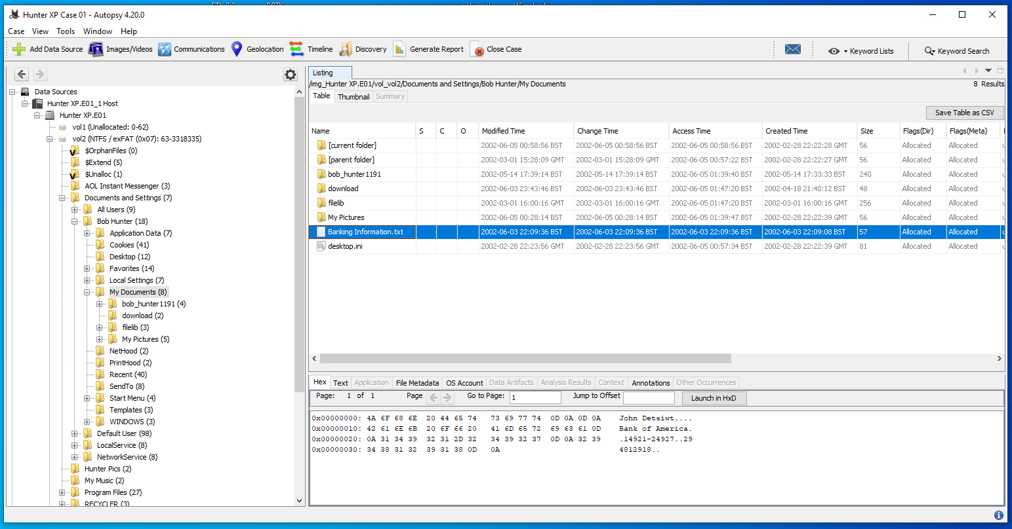
Notes:
10) Perhaps this banking information file means something ?

Slide 20
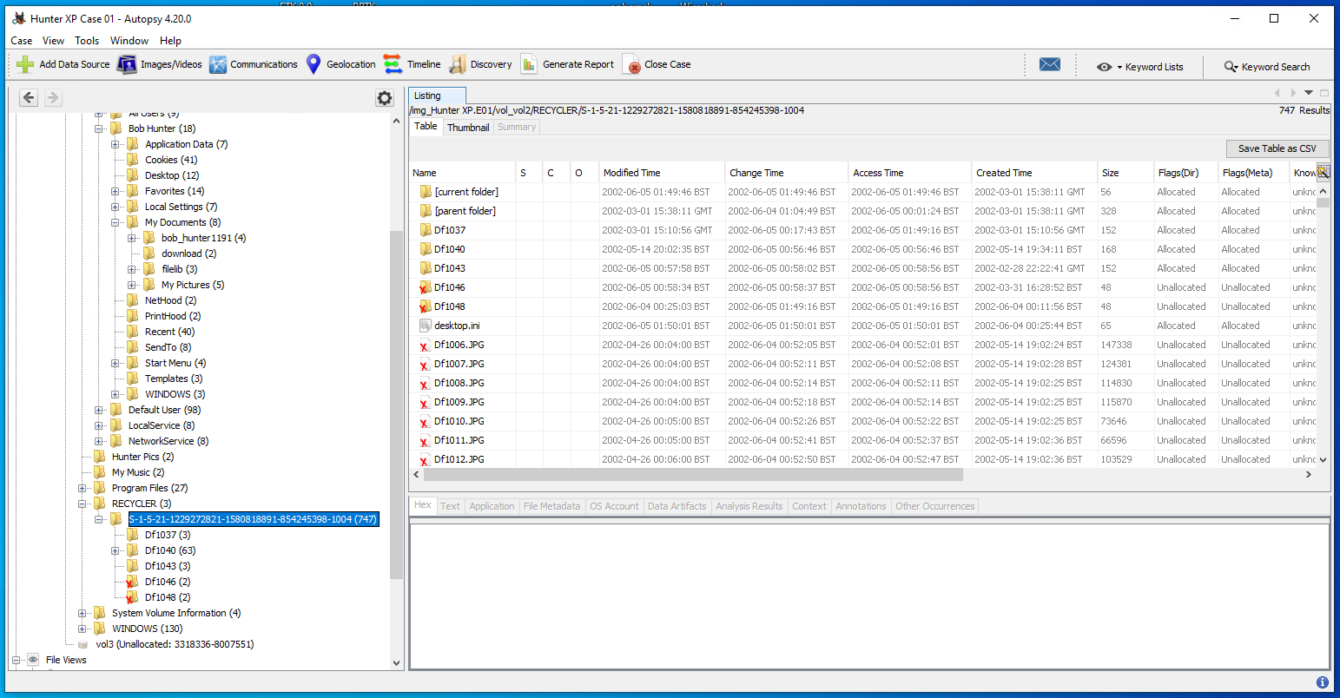
Notes:
11) We can also have a look at the recycle bin – we can see that the most recent user appears to have deleted some images.

Slide 21
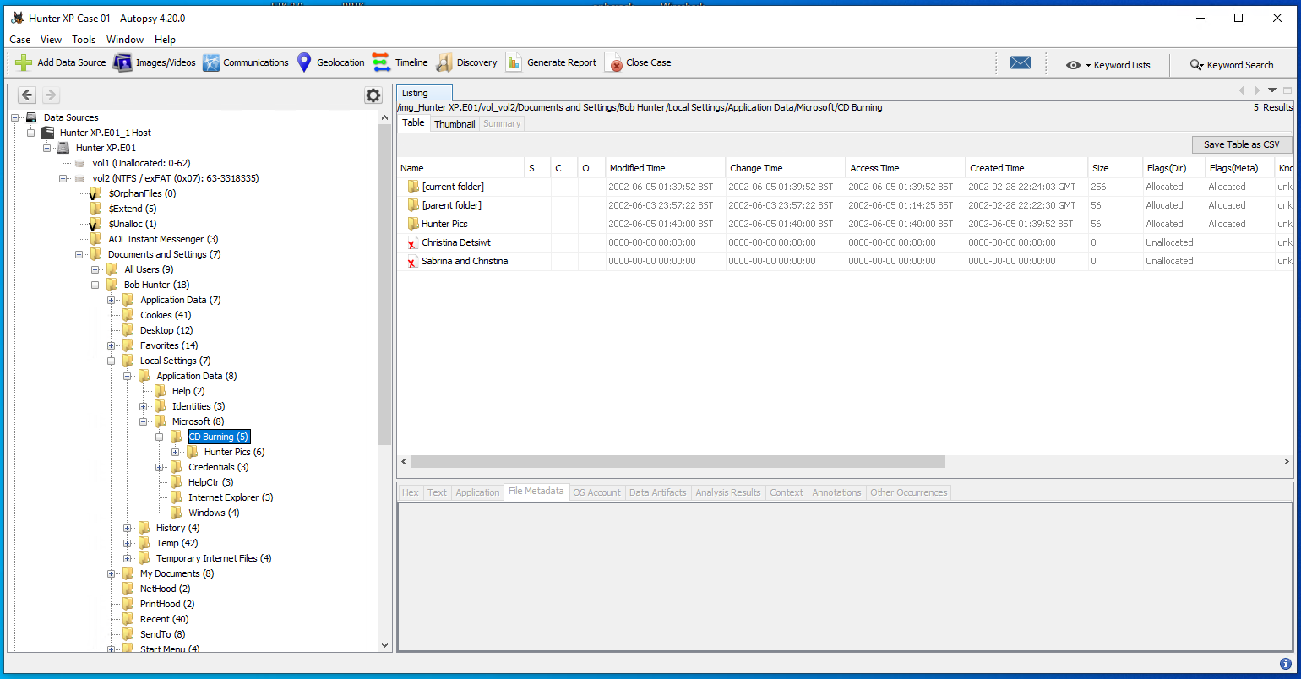
Notes:
12) With this version of Windows (Windows XP) we can check to see the most recent files burnt to a CD. In this case, we can see that the suspect loaded some of those deleted photographs onto a CD.

Slide 22
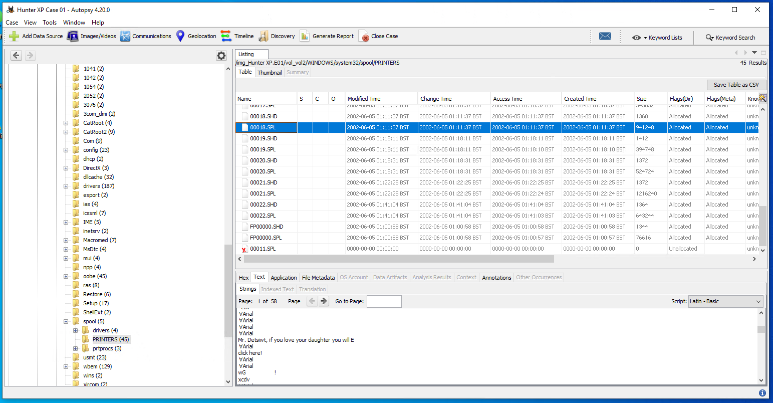
Notes:
13) If we have a look at the printing history of this Windows installation, we can find some clues that could potentially be evidence of a crime having been committed.
What other evidence can be found in the printing history?

Slide 23
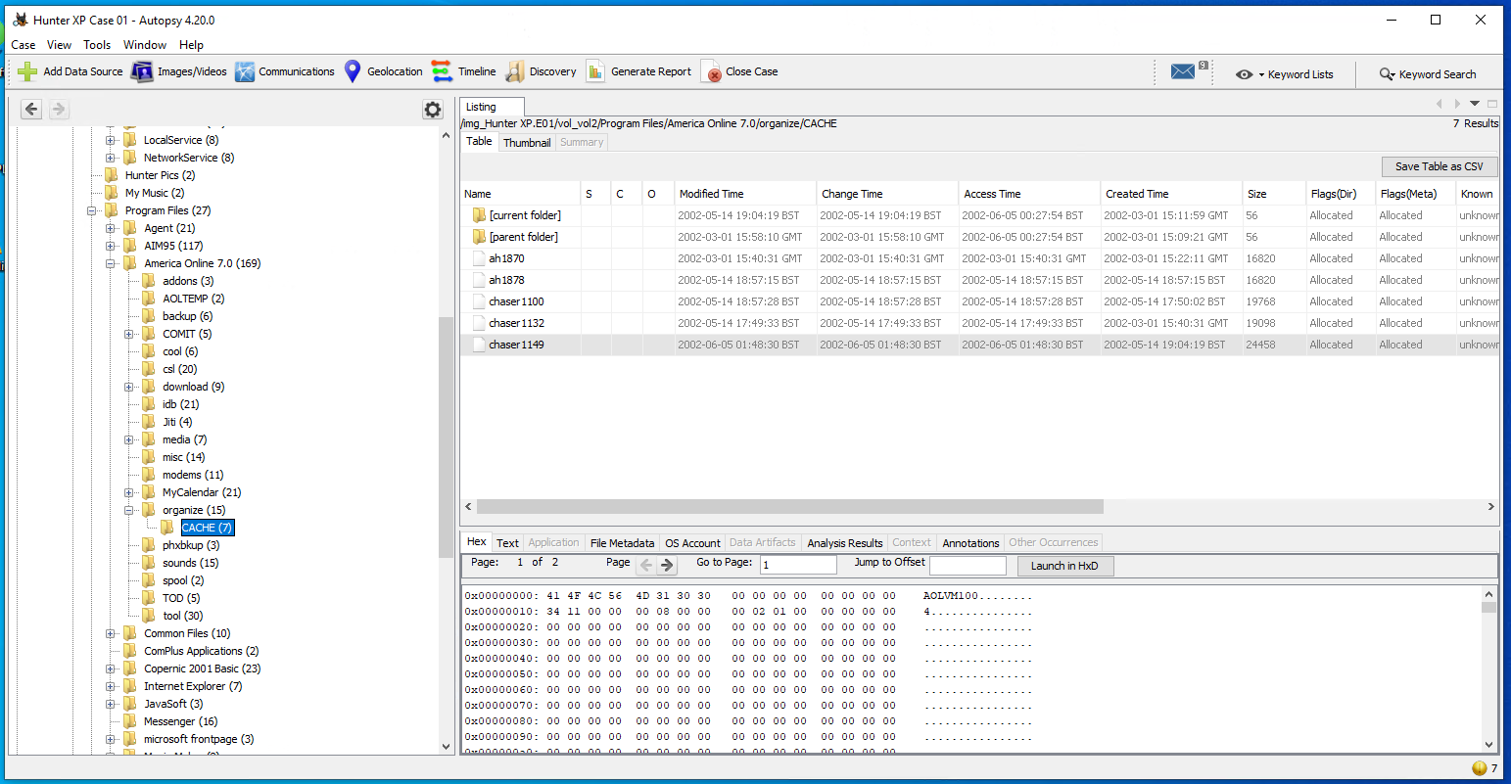
Notes:
14) We can also have a look at specific application history, such as emails or instant messaging – what can we get if we run some data carving modules on these types of files?

Slide 24
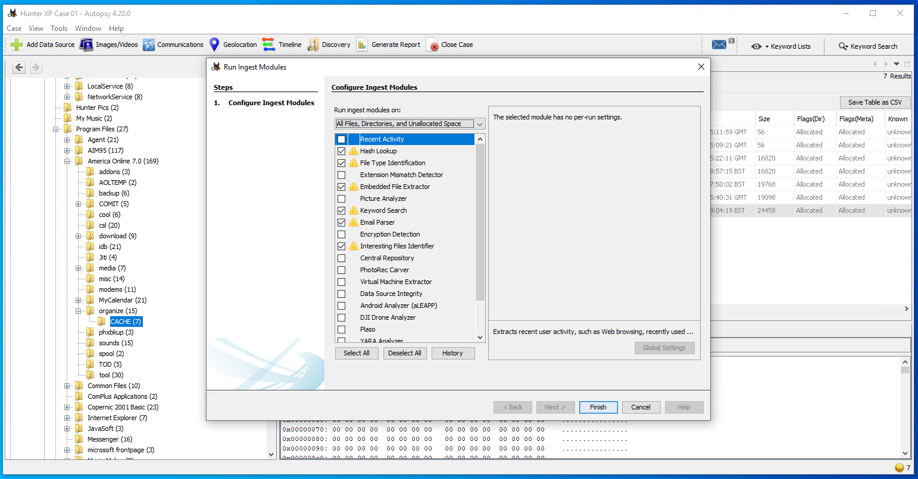
Notes:
15) Try running the selected ingestion modules (note that the yellow triangle will only show up if you have already ran these modules).

Slide 25
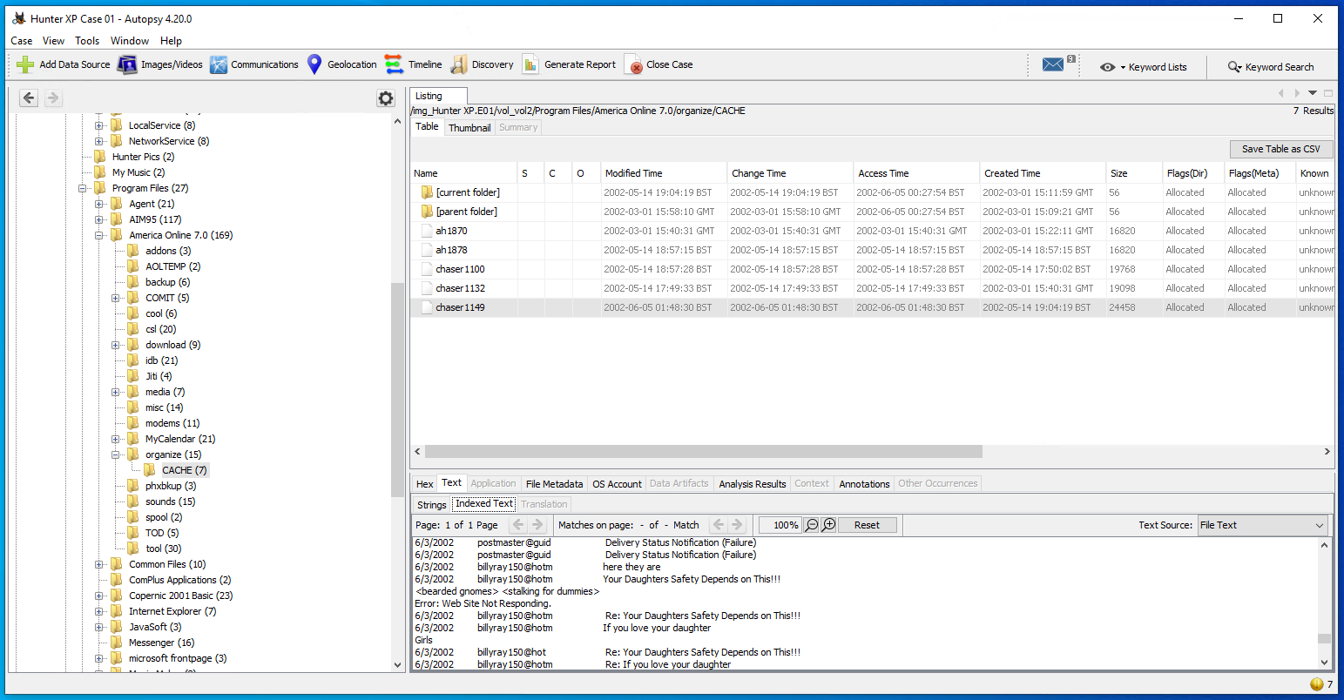
Notes:
16) After running those modules, checking the indexed text for history on this America Online account shows us some concerning subject lines in the users history.

Slide 26
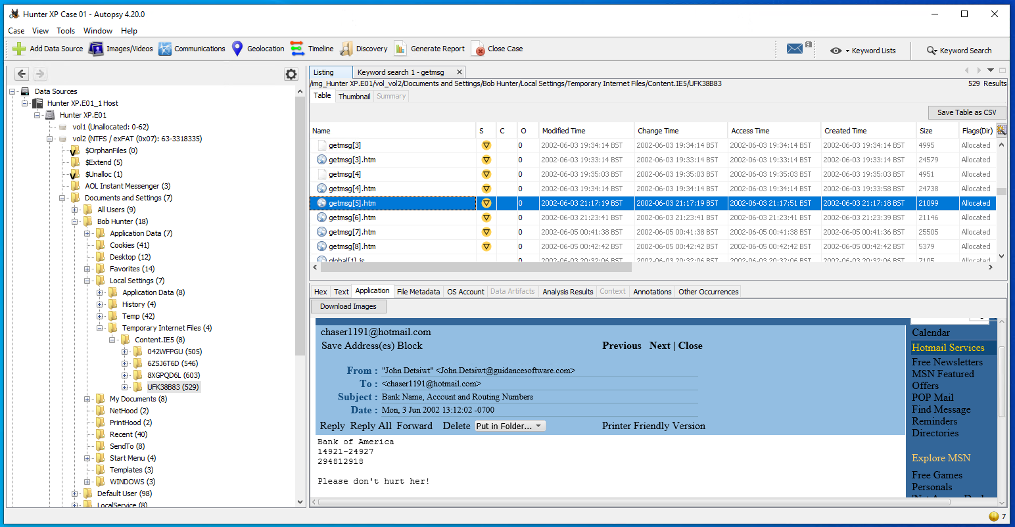
Notes:
17) With those ingestion modules having been run, we can also have a look and see what we can find from internet history. There’s certainly some concerning content in here.

Slide 27
Documenting findings
The suspects appears to have been following two women.
The women appear to be the daughters of a men named John and Ted.
There is evidence of extortion being made regarding the safety of this woman if payment is not received
Do you think this is enough to make a solid case?
Do you think there might be additional evidence to be found from further analysis of the disk image?

Slide 28
Anti-forensics
In scenarios where the potential criminal is aware of digital forensics, they may take steps to conceal data or prevent an investigation from being able to produce evidence.
Examples of anti-forensics:
Artifact wiping – removing files and data from the system forensically
Encryption – making the data unreadable without the key
Steganography – hiding secret information in a manner where it is difficult to establish it’s even present

Slide 29

Any Questions?
Thank You

